Slide 1

A Guide to
Created By: Rory McLaughlin
rmclaughlin27@qub.ac.uk
Concept and Idea: Dr. Reza Rafiee
g.rafiee@qub.ac.uk

Slide 2
What is Commentaire?
An extraction software system that fetches YouTube comment data from a YouTube video
It allows a user to have a closer, more detailed look at the comment section
Once the data is processed it is displayed in a variety of ways e.g. tables, graphs, wordclouds

Slide 3
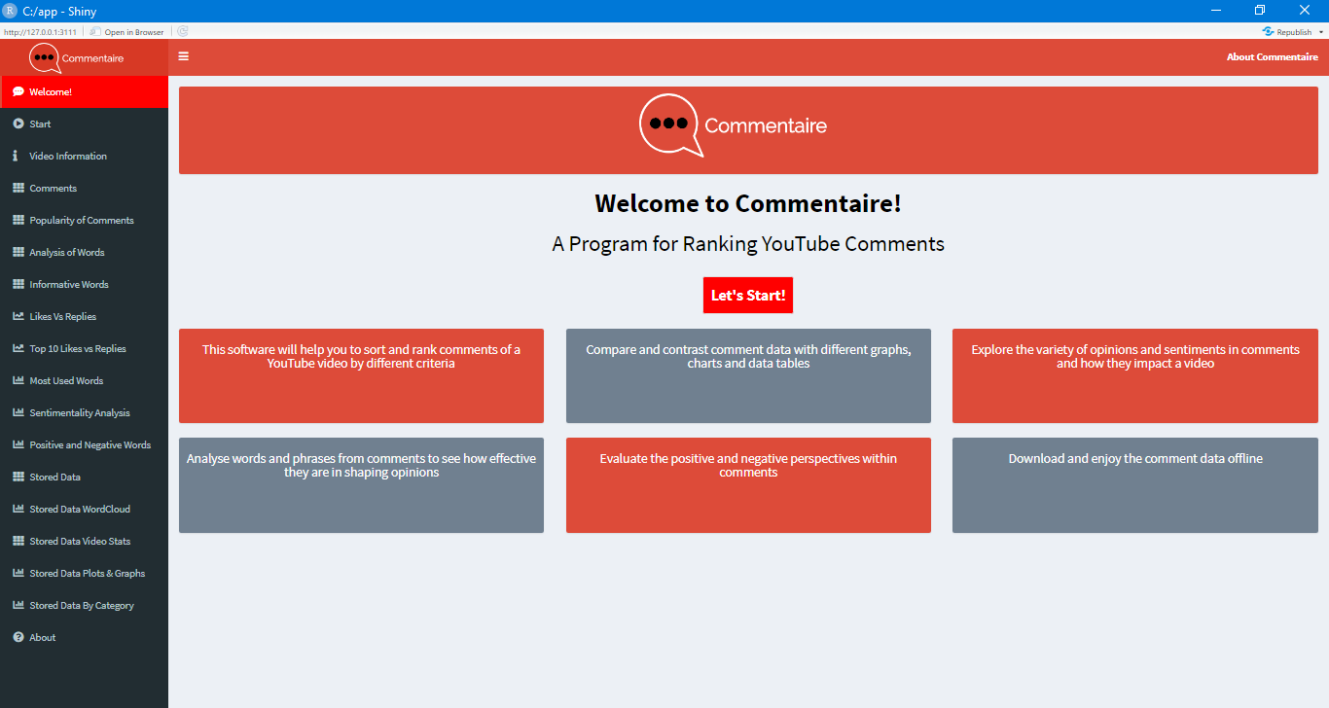
Let’s Start!
The software opens up on the ‘Welcome’ page with information explaining its purpose and an action button that says ‘Let’s Start’.
The user clicks on this to move on to the next tab

Slide 4
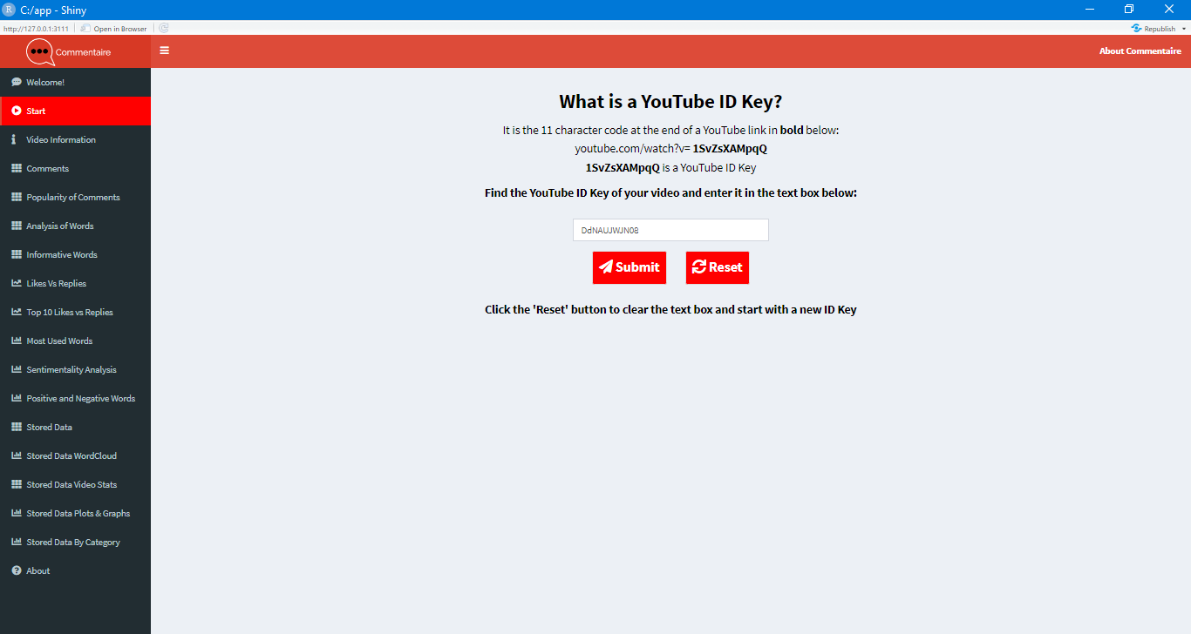
YouTube ID Key
This next tab details the background behind a YouTube ID Key.
This information is important for the user to understand as they cannot simply copy and paste a YouTube weblink into the text field.
They must use the ID Key as stated. Once they have it, they input it into the specified text field and click submit.
The option to click reset to remove an ID Key is also available.

Slide 5
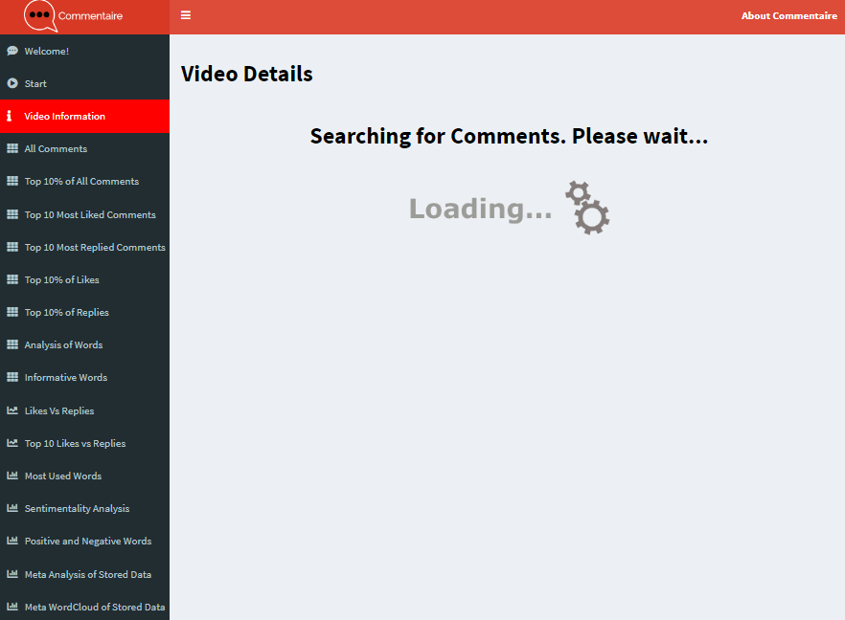
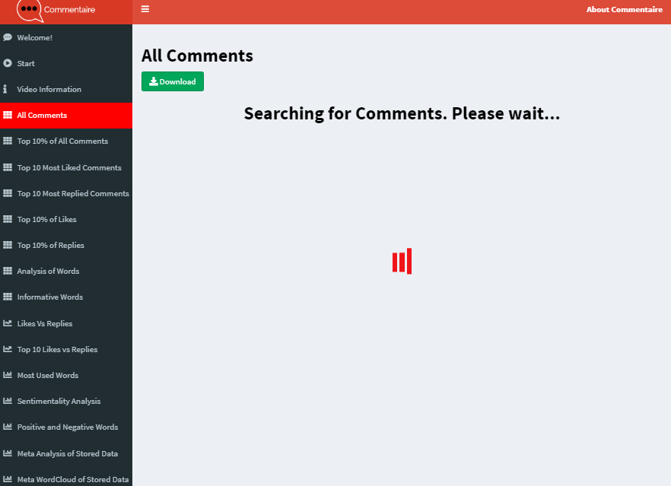
Data Loading…
Once the submit button is clicked it moves to ‘Video Information’.
Before the data is displayed, a loading prompt is shown.
This is shown in each tab to clarify for the user that the data is processing and it will take time to extract and display.

Slide 6
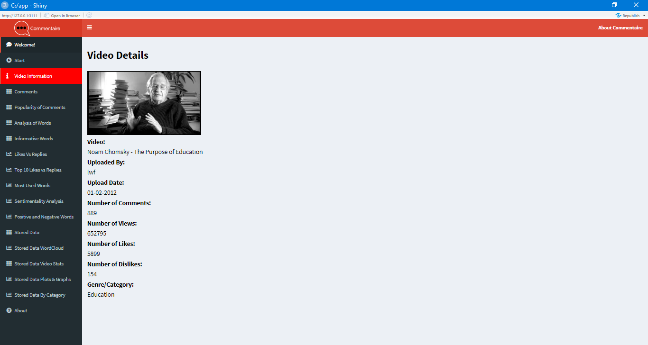
Video Details
Once the video is processed it shows the video details.
The thumbnail image for the video is shown to help users identify that it is the correct video visually.
The following details are also shown:
Video name, uploader, upload date, number of comments, likes and dislikes.

Slide 7
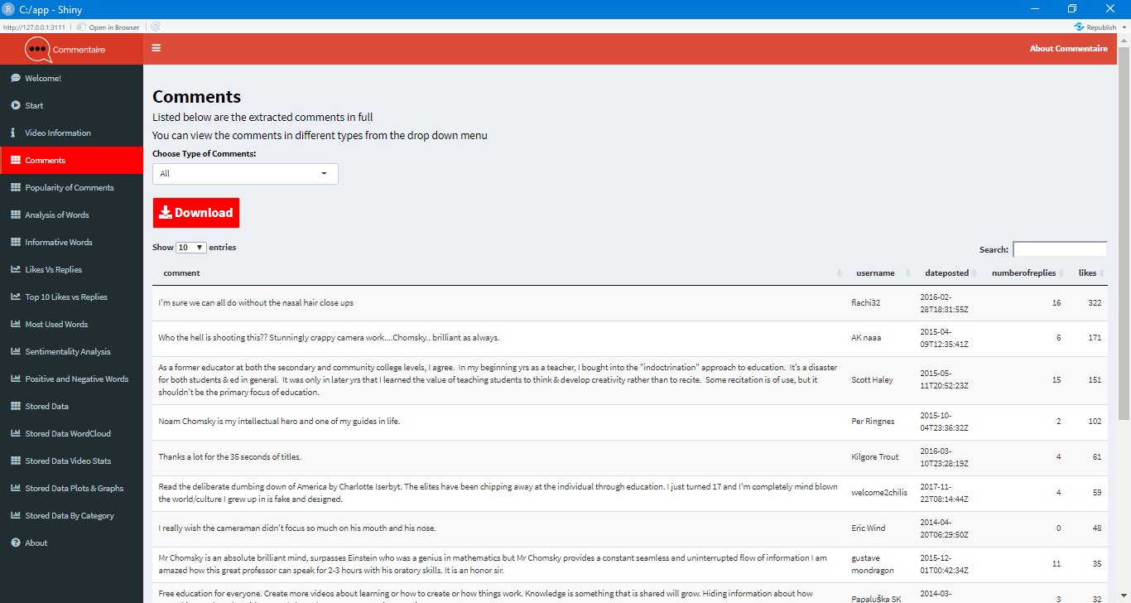
Comments
The next tab is the data table displaying ‘Comments’.
The table displays the following: Comment, Username, Date Posted, Number of Replies and Number of Likes.
The user can expand the amount of comments they can view on one page up to 100.
There is a search bar to search for a specific word, phrase or sentence.
There is a download button for users to have the ability to view this data offline.
The other tables – Top 10% of all comments, Top 10 Liked Comments, Top 10 Replied Comments and Top 10% Likes and Top 10% Replies are all very similar, so they won’t be detailed.

Slide 8
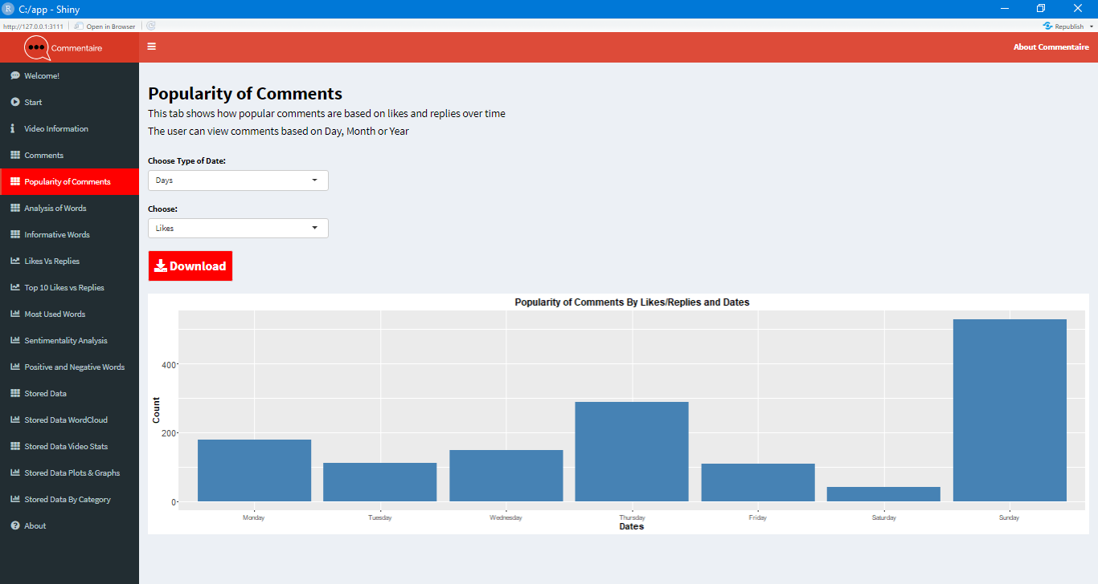
Popularity of Comments
This tab reviews how comments change in popularity over time going by the frequency of likes and replies.
The user can change the Date to 3 variables: Days, Months or Years.
They can flip between Likes and Replies to view how the popularity changes.

Slide 9
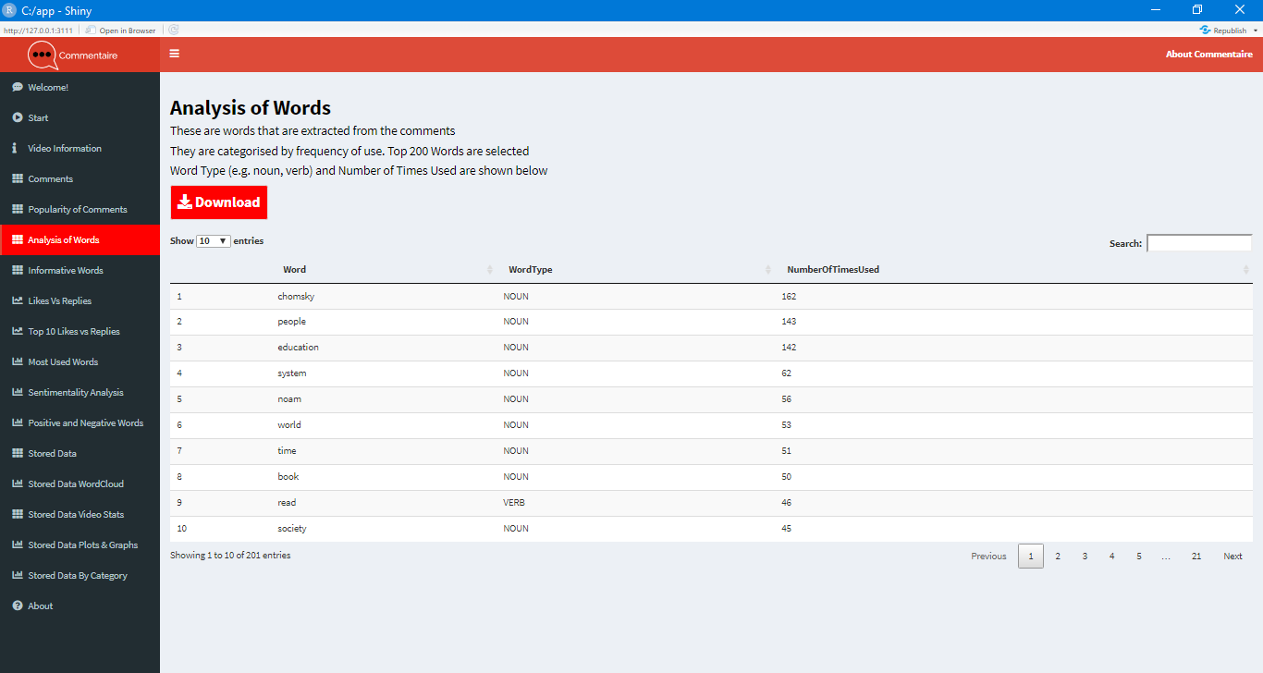
Analysis of Words
Analysis of Words is self-explanatory. The words are processed from the main comment data and output in single word form.
The words are tokenized (split from the comment sentences into single words) and identified by their word type (noun/verb/adverb) .
The words are assessed by how many times they appear in the comment text and organized by popularity.

Slide 10
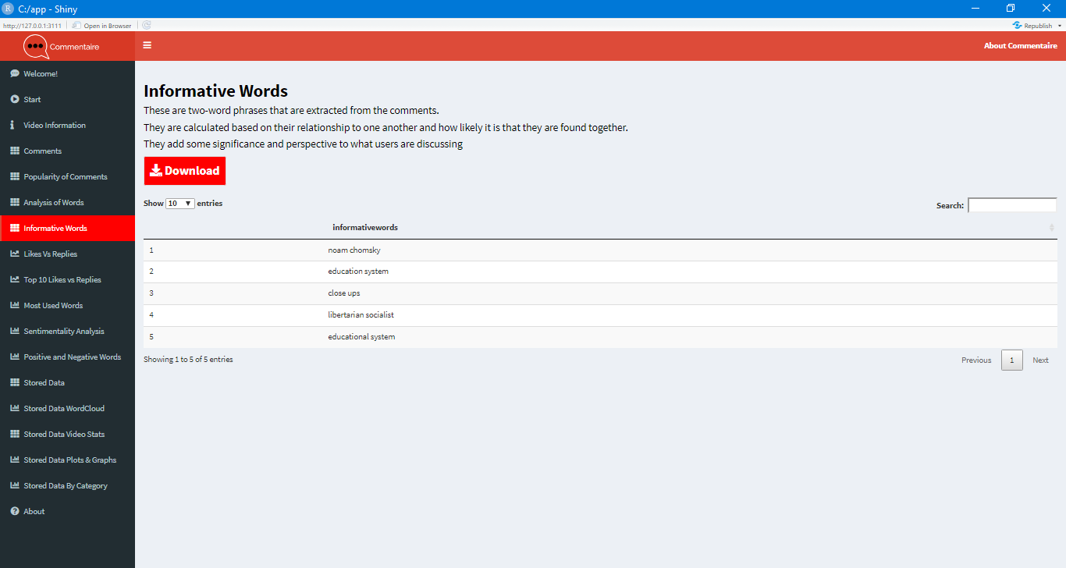
Informative Words
Informative Words are words that meaningfully connect.
The words are bigrams (two-word phrases) that capture a sense of what the video and the comment section is about.
The data to the right shows ‘noam Chomsky’, ‘education system’. The video chosen is called ‘Noam Chomsky – The Purpose of Education’.
These words have relevance and represent the atmosphere of the discussion.

Slide 11
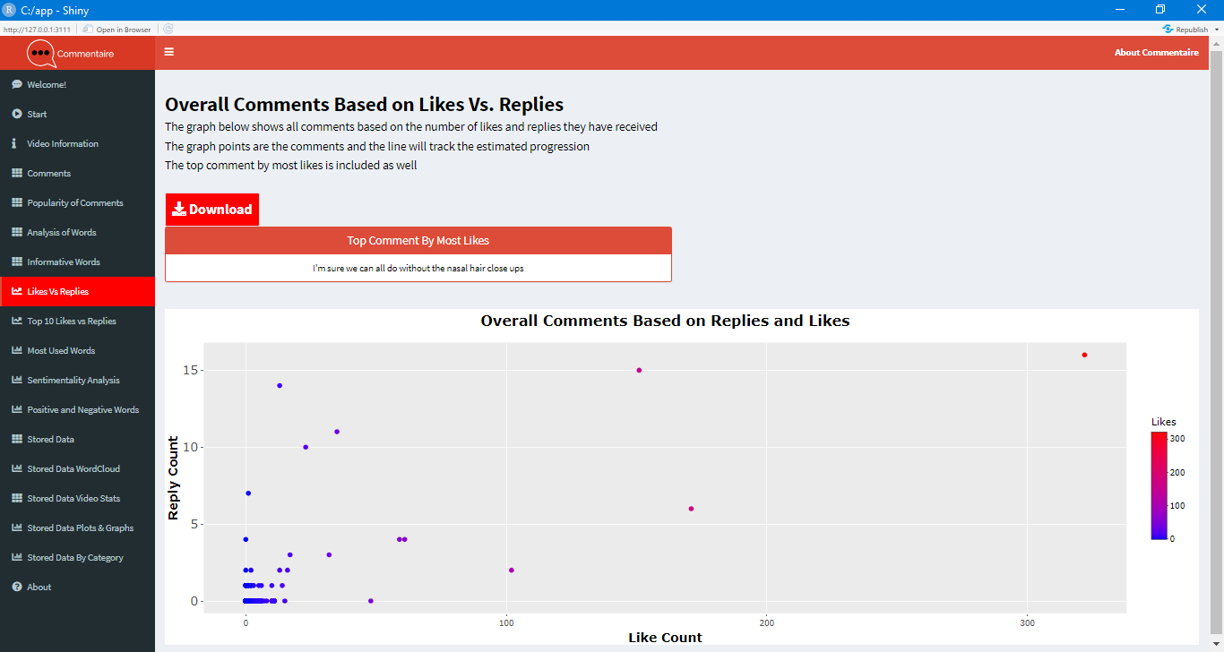
Overall Comments Based on Likes Vs. Replies
This tab is a graph that coordinates Comments based on Likes in comparison to replies.
The Top Comment by the most likes is shown above it.
In the example to the right, most comments are concentrated in the lower end but then there is a smattering of comments that grow with likes and replies.
As the likes and replies increase, less comments make it to the top.

Slide 12
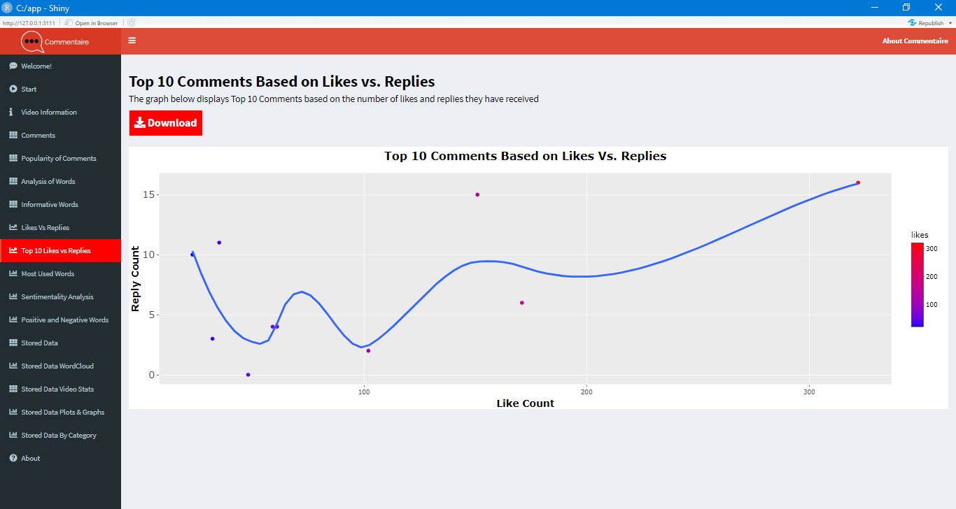
Top 10 Comments Based on Likes vs Replies
This is a more specific look at comments that have the most likes and replies.
The regression line designates the path that compares the two variables – Likes and Replies.
Like the previous tab, most comments are on the lower end while the top comment with most likes and replies is a distinct outlier.

Slide 13
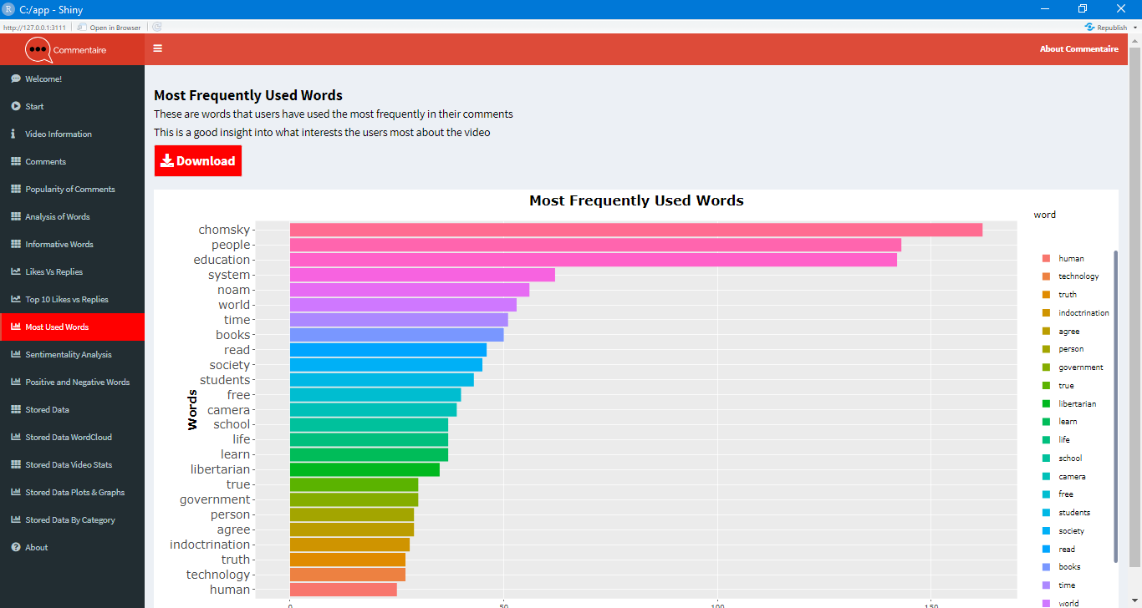
Most Frequently Used Words
The words are categorized by how frequently they were used in the comments and then output in a colour-coded diagram.

Slide 14
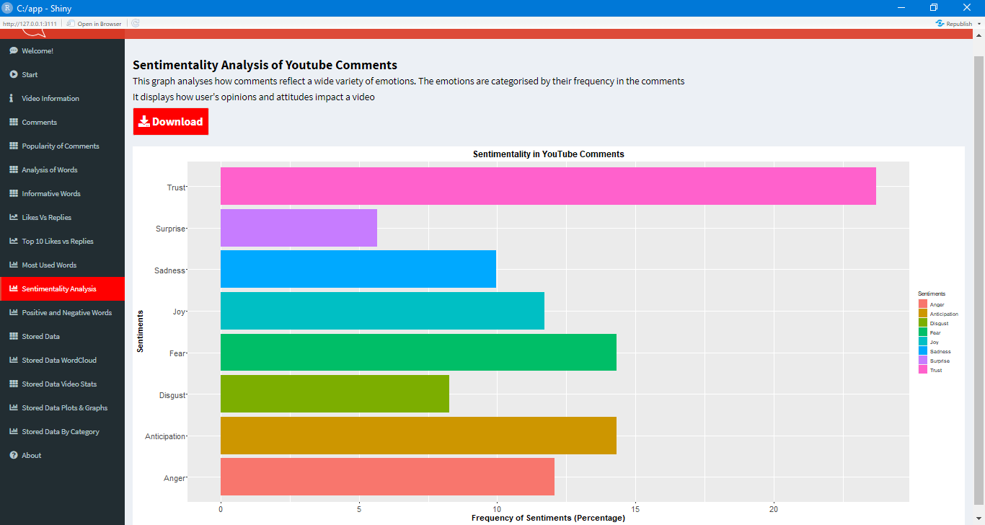
Sentimentality in YouTube Comments
Sentimentality is an assessment of the emotional responsiveness within comments. It shows how the attitudes and opinions of users can vary. There are 8 sentiments that the comments can identify with: Trust, Surprise, Sadness, Joy, Fear, Disgust, Anticipation and Anger. In this instance Trust, Anticipation, Fear and Joy are the most defined sentiments of the comments.

Slide 15
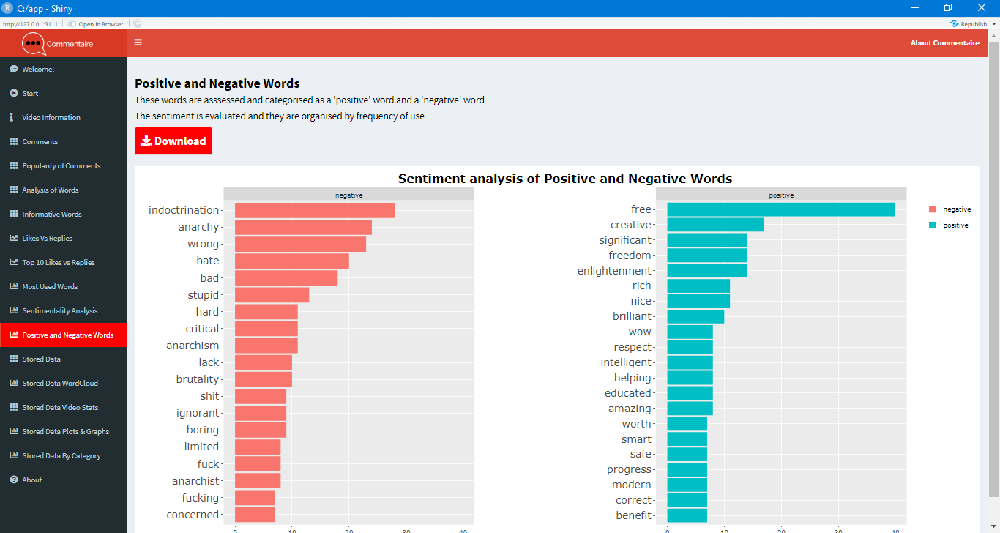
Positive and Negative Words
This tab looks at how specific words in the comment data can be identified as either positive or negative. Words are mined for sentiment (positive or negative) and output based on frequency of use.

Slide 16
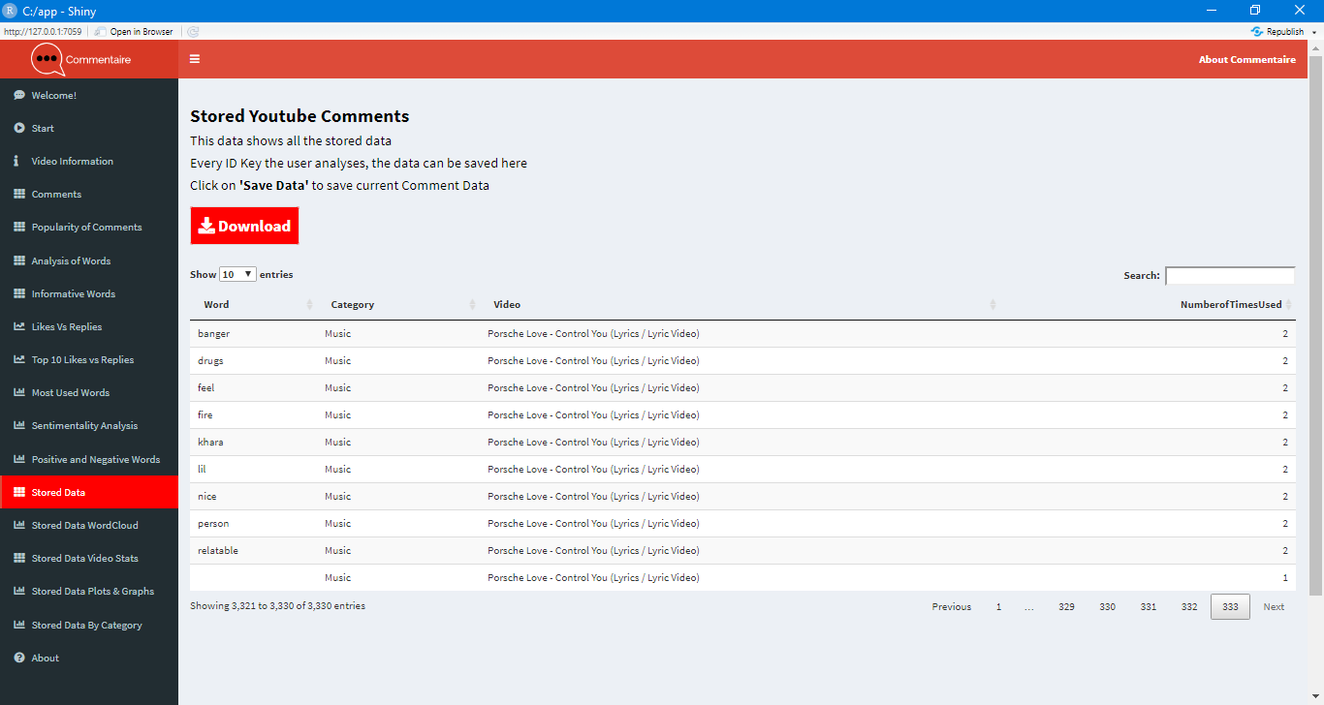
Analysis of Stored Comment Data
This is locally stored data of the comment data that is input into the software. It is stored temporarily and separate from the session data a user interacts with in the other tabs.
This stored data is important as it combines each video’s data and mines the comments for words that are frequently used in each stored video comment data.

Slide 17
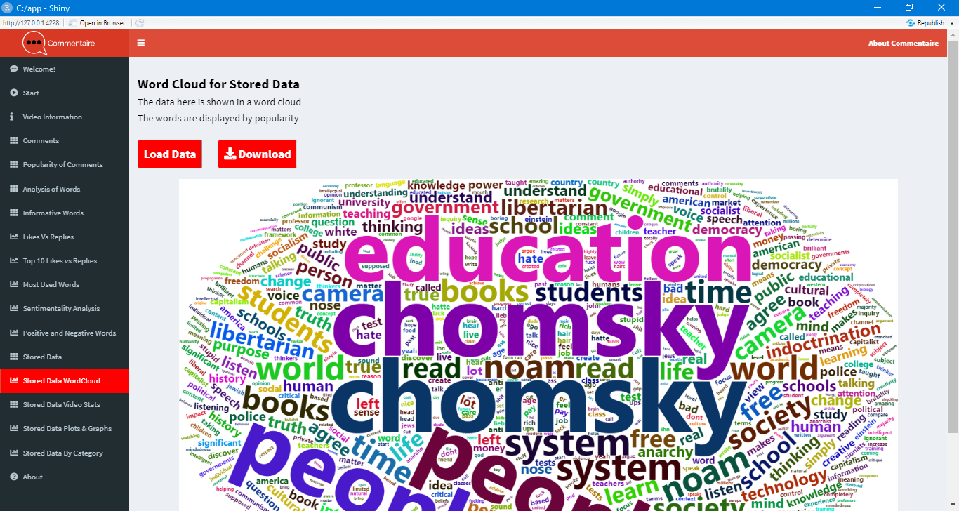
Word Cloud of Stored Comment Data
This tab looks at how specific words in the stored comment data are popularized within a word cloud. Going from the center outwards, the words get bigger in size based on popularity and frequency of use.

Slide 18
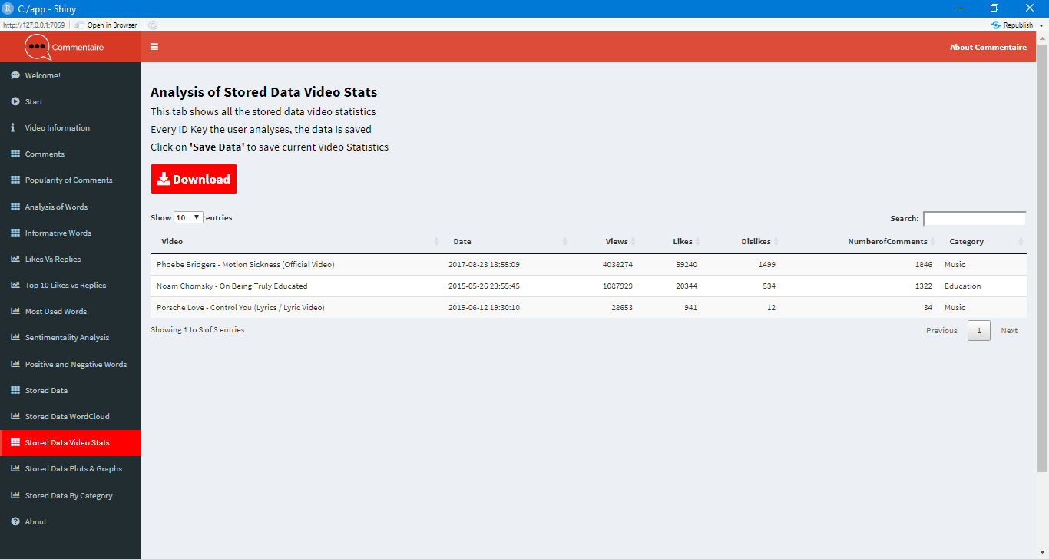
Stored Comment Data Video Stats
This tab shows the video statistics of the stored data. There are a lot of statistics here that can be compared in evaluated in plots and graphs.

Slide 19
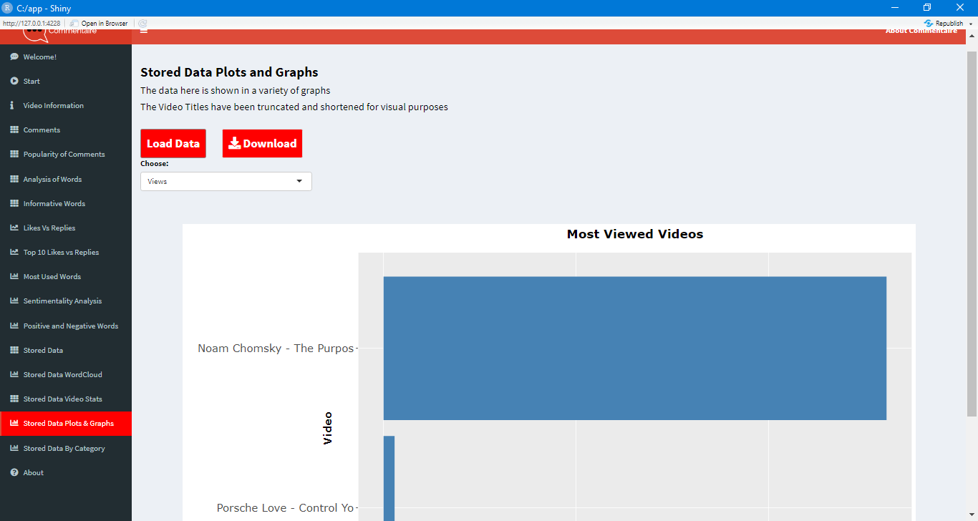
Stored Comment Data Plots & Graphs
This tab shows the different aspects of the stored video data visually. The user can compare the number of Views, Likes or Dislikes of the videos they have stored.

Slide 20
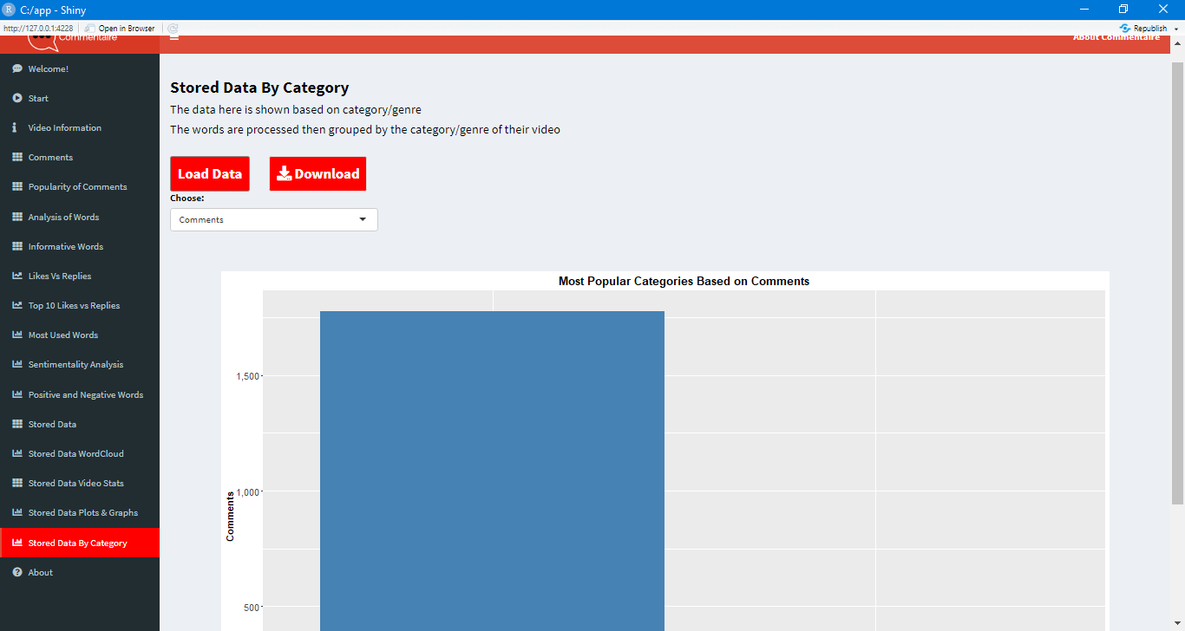
Stored Comment Data By Category
The user can view their stored video data by category in this tab. The options are Comments, Word Frequency, Views, Likes and Dislikes.

